Slide 1
ISO/TC 11 & OGC Update
Chris Body

Slide 2
ISO/TC 211 Outcomes from Plenary Meeting (3-7 Jun 19)
ISO/TC 211 & ISO/204 Intelligence Transport Systems gap analysis for Geographic Data Files (GDF) and ISO/TC 211 Conceptual Models improve harmonisation
LADM Working Draft to be submitted by the end of the year. Have a multi-part standard
Land Administration Fundamentals
Land Tenure or Land Registration or Land Interest
Marine Space or Marine Geo-regulation
Land Valuation
Spatial Planning
Implementation

Slide 3
ISO/TC 211 Outcomes from Plenary Meeting (3-7 Jun 19)
Mirror amendments to fix errors in ISO/19115-2:2019 Metadata – Part 2: Extensions for Acquisition & Processing
Revision of ISO 19157:2013 Data Quality
Confirmed ISO 19115-1:2014 Metadata – Part1: Fundamentals
Public release of ISO Geodetic Registry

Slide 4
OGC Recent Developments
New Domain Working Groups
EO Exploitation Platform DWG
Statistical DWG
AI in Geoinformatics
Blockchain and Distributed Ledger Technologies DWG
Portrayal DWG

Slide 5
OGC Active Votes
OGC PipelineML as a new standard
OGC OpenSearch Extension for Earth Observation (OpenSearch-EO) as a new standard
OGC EO Dataset Metadata GeoJSON Encoding as a new standard
OGC OpenSearch-EO GeoJSON Response Encoding as a new standard

Slide 6
OGC and ISO/TC 211
OGC API – [resource]
=
Geospatial API for [resource]

Slide 7
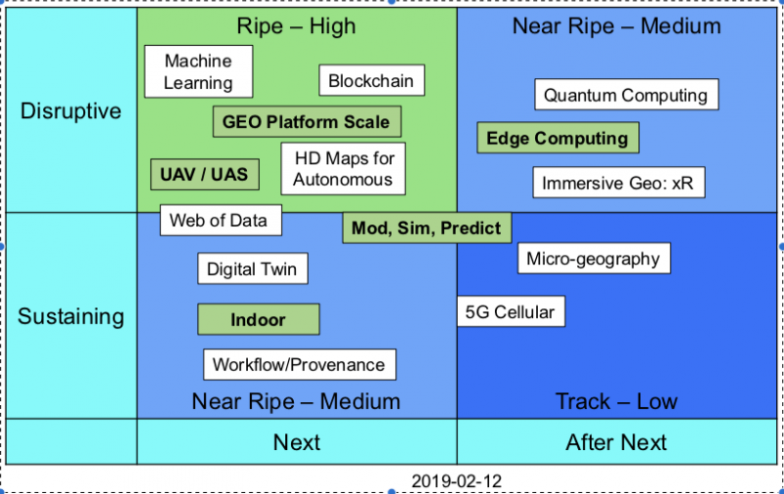
Technology Trends

