Slide 1
ANZLIC/ICSM Metadata Working Group Meeting
National Archives of Australia - next information policy post Digital Continuity 2020
23rd March 2020
Notes:
Welcome
Acknowledgement of Country
I would like to acknowledge the traditional custodians of the land on which we meet and to pay my respects to their elders past and present and future

Slide 2
Digital Continuity 2020
Information is managed digitally
Robust information management
Information
is valued
Information is interoperable
Notes:
National Archives of Australia has a current policy - Digital Continuity Policy 2020 which was released in 2015 and concludes 31 Dec 2020.
Its purpose is:
to support the Australian Government's digital transformation initiatives and to drive digital government.
to enable agencies to understand and fully realise the benefits of their assets – information, technology, people and processes – in order to deliver better and more efficient services to Australians.
The Digital Continuity 2020 Policy integrates information governance principles and practices into the work of agencies to
optimise the delivery of government programs and services;
enable information reuse for economic and social benefits; and
protect the rights and entitlements of Australians.
The policy promotes a consistent approach to information governance across the Australian Government and within individual agencies.
It applies to government information, data and records, as well as systems, services and processes.
The three principles under the policy are:
Information is valued, meaning that agencies manage information as an asset. Increasing the potential value of information by ensuring it is accountably created, managed, described and stored. The end goal being that agencies manage their information assets for as long as required.
Information is managed digitally by transitioning to digital work processes with fully integrated digital information management. The end goal being that by 2020 agency interactions, decisions and authorisations are recorded digitally
Information, systems & processes are interoperable. The end goal being that information is managed based on format and metadata standards with all business systems meeting functional requirements for information management.

Slide 3
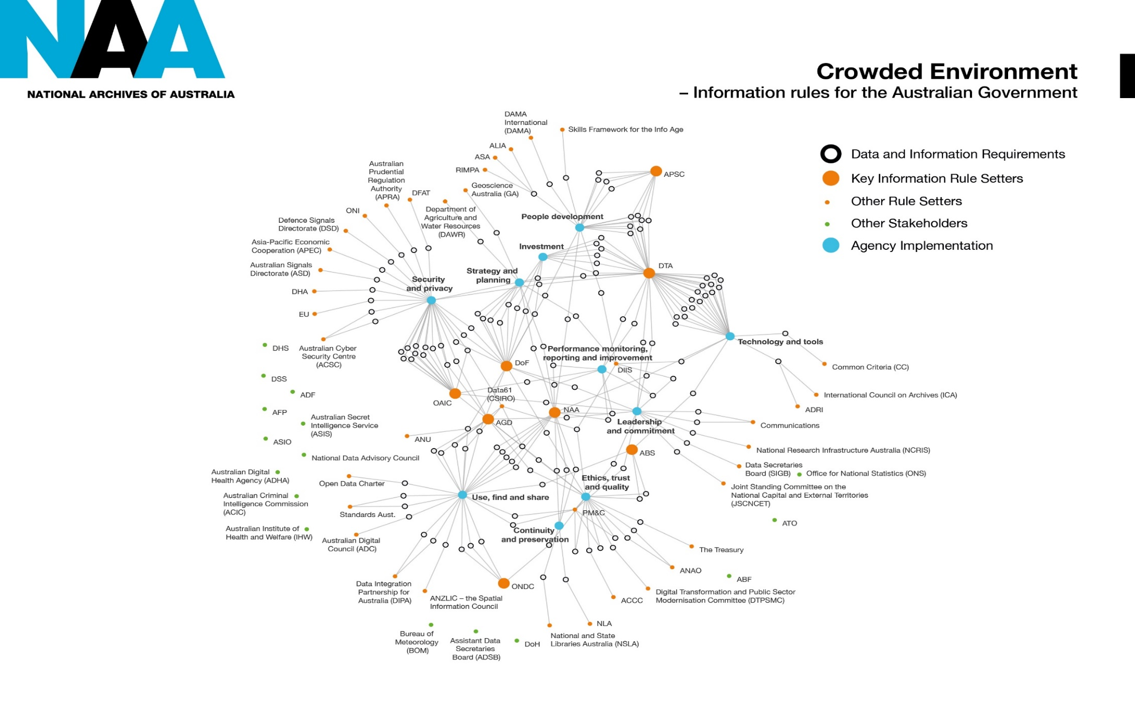
The need for an Australian Government
Information Management Framework
Notes:
One aspect of the current environment that the National Archives has been examining is the number of agencies setting information requirements for the Australian Government.
[Irina – the audience is expected to get the detail of this slide – just that there are a lot of agencies with some involvement in information policy]
The key ones are highlighted by the large orange dots. They are:
Attorney-General’s Department
Australian Public Service Commission
Department of the Prime Minister & Cabinet
Department of Finance
Digital Transformation Agency
Office of the Australian Information Commissioner
Office of the National Data Commissioner
Australian Bureau of Statistics
The National Archives is working with these agencies through Round Table meetings during the development of its next data and information policy. This is to avoid creating duplicated or conflicting requirements in data and information management as well as looking for opportunities for collaboration in the policy or its implementation.

Slide 4
Next information management policy
National Archives will:
collaborate with key data and information policy agencies to develop next policy
build on its previous policies to further increase data and information management maturity in Australian Government
facilitate broader Australian Government initiatives including:
Australian Government Public Data Policy Statement & Strategy
Digital Transformation Strategy
Open Government
National Data Sharing and Release
Trust
Broader government agendas
Notes:
So as a summary why the National Archives’ is developing the new policy is on the slide in front of you

Slide 5
Policy focus areas
Trust
Information Governance
Identifying and managing datasets according to value
Building professionalism
Culture
Interoperability
Metadata
Interoperability maturity
Storage and preservation
Digital preservation
Govern & manage storage for information assets
Disposal
Legacy information and systems
Sentencing of digital records
Broader government agendas
Notes:
This slide shows the policy focus areas around which National Archives is developing the policy.
Policy focus area were informed by:
Capability gaps identified through National Archives 2018 and 2019 Check-up Plus survey results of Australian Government information management maturity
Environmental scans of current and emerging data and information challenges
Support of broader digital transformation and open government agendas
Agency stakeholder consultation.
Many of these focus areas reinforce themes of the Digital Continuity policy and the National Archives’ Information Management Standard, with a focus to reflect capability gaps identified in the current environment since these were released.
Trust
The concept of trust has emerged as important overarching theme for the policy to address, as data and information must be accurate and trustworthy to inform Government interactions with citizens, support current government business and enable future use and reuse. Trust is also vital to support the Government’s transformation objectives.
Information governance
While some aspects of information governance are quite strong across government, remaining capability gaps include:
Identifying and managing data across its lifespan and assessing risk
Valuing and developing skilled information and data management professionals to build an organisation’s strategic capability
Fostering a culture that values and manages information as an asset and an enabler for business use and community reuse, addressing many behavioural rather than system issues that are barriers to better information and data capability within agencies.
Interoperability
A major theme continuing from the previous policy, recognising that interoperability of information is essential to ensure it can be shared within or outside an organisation, to achieve the government’s digital service delivery and data sharing objectives.
Metadata is a key tool to enable interoperability
Storage and preservation
A strong theme continuing from the previous policy, as business information needs to be stored securely and preserved in a useable condition to support business needs and community access.
Disposal
Disposal was the lowest performing capability in our recent Check Up Plus survey reports.. Over-retention of information is costing the Government unnecessary storage costs as well as making needed information harder to find.

Slide 6
Draft policy outline
Managing Trusted Data – for government and community
Purpose
The policy will improve the capability and performance of Australian Government agencies in creating and managing fit-for-purpose data and information.
Notes:
The National Archives has a draft policy outline for the new policy with the current title of Managing Trusted Data- for government and community
Its stated purpose is: to improve the capability and performance of Australian Government agencies in creating and managing fit-for-purpose data and information.

Slide 7
Draft policy statement
Agencies will manage data and information strategically with appropriate governance and reporting arrangements to effectively meet the current and future needs of clients, government, business and the general public.
Agencies will have fit-for-purpose data and information management systems, processes and practices based on identified requirements for creation and use.
Agencies will reduce data and information inefficiency and risk through improving processes and systems with negative impacts on business productivity.
Notes:
The draft policy statement or desired state covers:
Governance
Fit-for-purpose data and information management systems, processes and practices
Reducing inefficiency in managing data and information.
One important aspect of fit-for-purpose data and information management systems, processes and practices is metadata and metadata management.
Adequate and standardised descriptive information facilitates business use and data sharing, and ensures the context and content of data is known, can be verified, and can be understood.

Slide 8
Questions
What are the current metadata challenges for the Australian Government?
How can these be addressed?
Less than half of agencies have adopted relevant metadata standards
Check-up Plus 2018
Notes:
The National Archives is sorry it can’t be at today’s meeting. One conclusion that it’s research has found is that Australian Government agencies are still struggling with metadata.
These questions are posed for consideration.
National Archives would be particularly interested in any solutions through policy, or other means, that you might suggest.
[Irina – the next slide has an email address which participants can send any feedback or thoughts to the National Archives. Could you also let participants know that we will look to distribute the Exposure Draft which we are hoping to send out in May to the Group]

Slide 9
Next Steps
Email thoughts and suggestions to information.management@naa.gov.au

