Slide 1

S-100 across the channel
(Shom – UKHO S-100 ECDIS project)
AUSTRALIA S-100WG - 23 March 2023 Thomas Mellor (UKHO) - Christian Mouden (Shom)

Slide 2
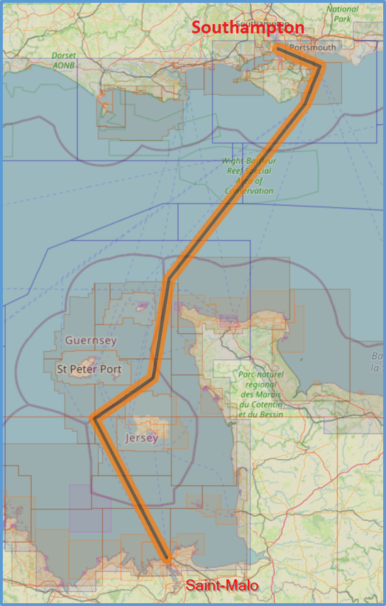
Project overview
Test of S-100 ECDIS systems (including Dual Fuel mode) on a route between Southampton and Saint-Malo.
The UKHO and Shom will produce a range of S-100 datasets, which will be trialled in S-100 capable navigation systems.
Australia S-100 National Stakeholders WG Meeting - 23 March 2023 Thomas Mellor (UKHO) - Christian Mouden (Shom)

Slide 3
Project objectives
General objective: Provide evidence that S-100 ECDIS does not effect navigational safety
Individual goals:
  Tests UKHO and Shom S-1XX product processes (including S-57 S-101 conversions and dual fuel production);
  Test ECDIS Dual-fuel mode (S-57 + S-101 ENCs);
  Test S-100 product transmission from the producer to the mariner (incl. S-100 cybersecurity);
  Test S-101 loading strategy for ENCs (and evaluate the display);
  Test S-1XX data visualization on the S-100 systems;
  Test S-98 interoperability (TBC).
Australia S-100 National Stakeholders WG Meeting - 23 March 2023 Thomas Mellor (UKHO) - Christian Mouden (Shom)

Slide 4
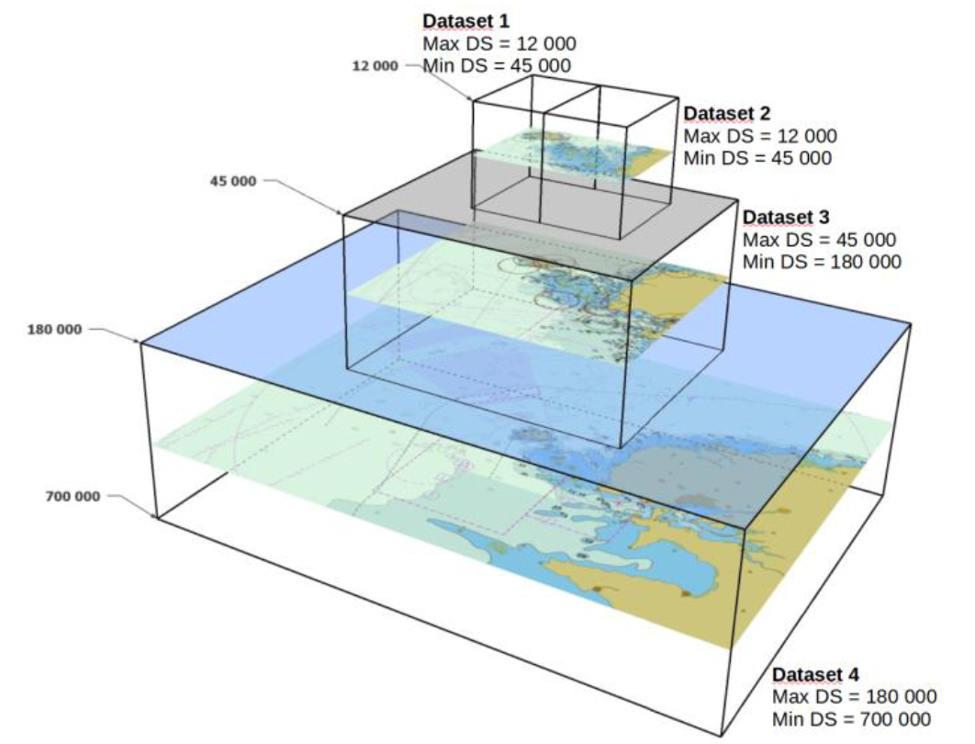
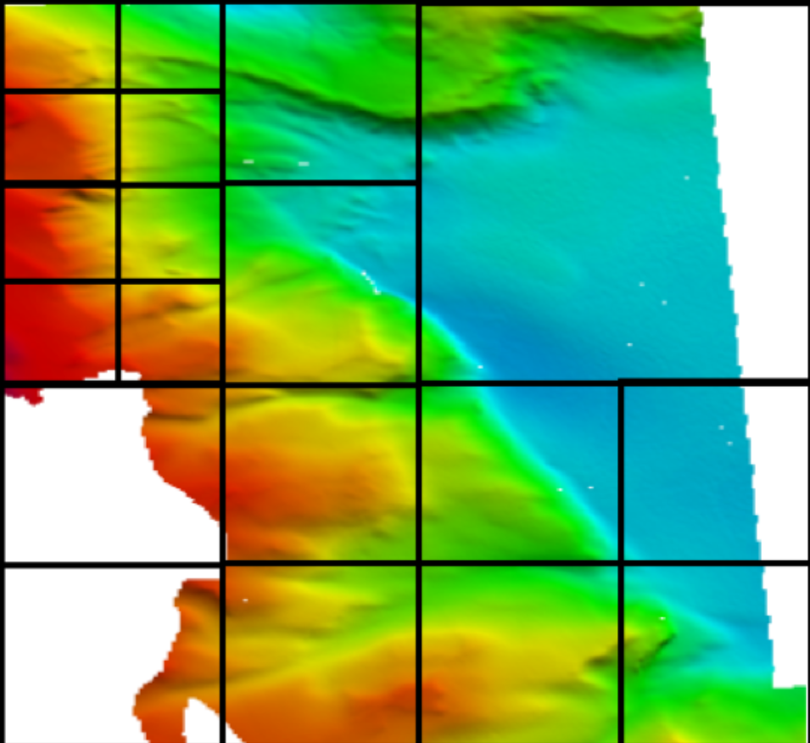
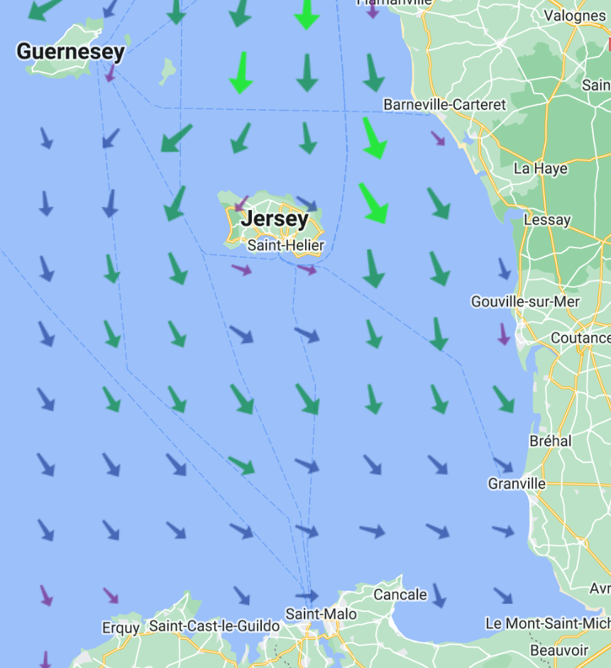
The S-1XX products for the project
  ENCs: S-57 and S-101 (ed. 1.1.0);
  S-102 (Bathymetric surface – ed. 2.2.0);
  S-104 (Water levels – ed. 1.1.0);
  S-111 (Surface currents – ed. 1.2.0);
  All products will be in line with S-100 Edition 5.0.0.
Test data available on: https://datahub.admiralty.co.uk/portal/apps/sites/#/marine-data-portal/pages/s-100
https://diffusion.shom.fr/
Australia S-100 National Stakeholders WG Meeting - 23 March 2023 Thomas Mellor (UKHO) - Christian Mouden (Shom)

Slide 5
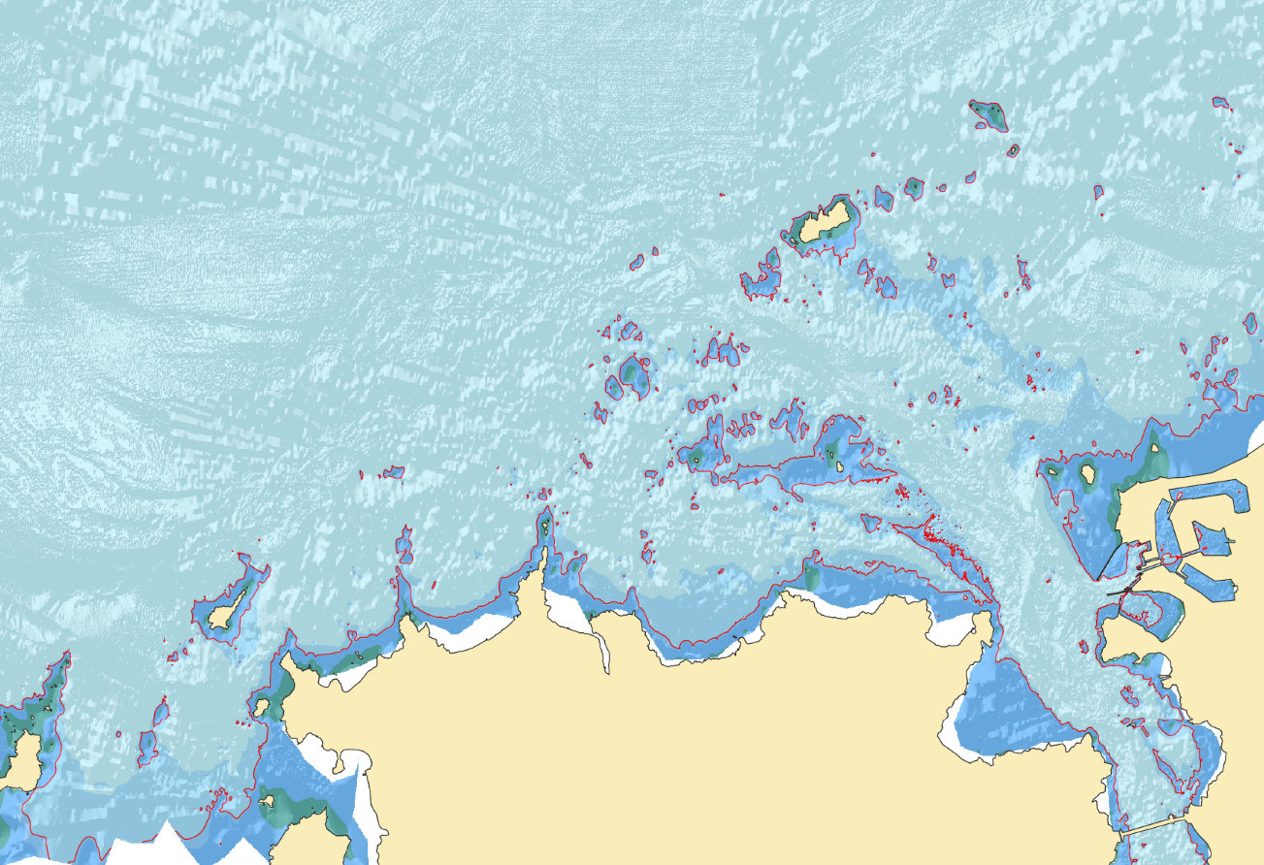
The S-1XX products
  But also:
  S-128 (Digital product catalogues*);
  S-98 (Data Product Interoperability**)
  *: issued by the RENCs
  **: subject to OEM system capabilities
Australia S-100 National Stakeholders WG Meeting - 23 March 2023 Thomas Mellor (UKHO) - Christian Mouden (Shom)

Slide 6
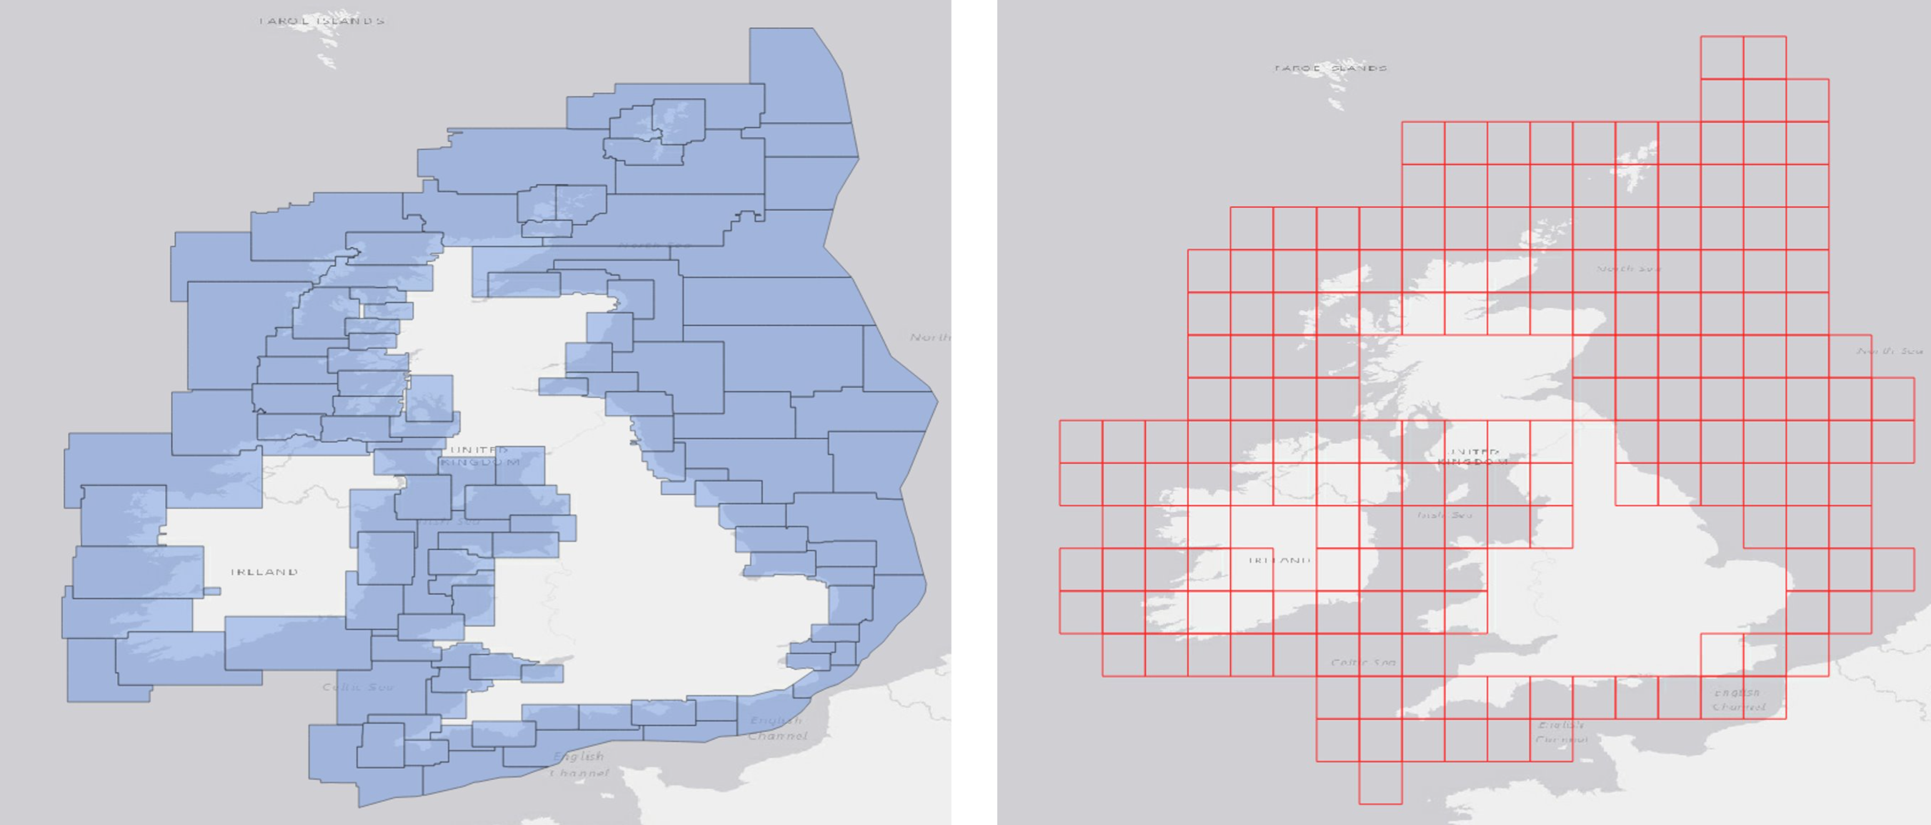
S-101 Data production
  Conversion of S-57 Data into S-101 (Edition 1.1.0)
  Addition of S-101 new features
  Portrayal and ECDIS functionnalities:
      Sectored lights
      Text display, etc.
  Production of Updates (ER) – (S-57 and S-101)
  Production of auxiliary files (.tiff / .txt)
  Setting of Max. and Min. Display Scales (seamless ENCs at the border)
  Regular grids (UKHO) vs « traditional » coverage (Shom)
Australia S-100 National Stakeholders WG Meeting - 23 March 2023 Thomas Mellor (UKHO) - Christian Mouden (Shom)

Slide 7









Project stakeholders
RENCs:
OEMs:
Sea trials: (TBC) (TBC)
      UK and French Navy vessels
Australia S-100 National Stakeholders WG Meeting - 23 March 2023 Thomas Mellor (UKHO) - Christian Mouden (Shom)

Slide 8
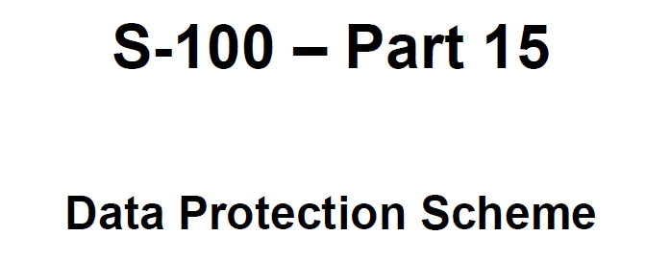
Data distribution
Data delivery from Hydrographic Offices to their RENC
RENC delivery to the Value Added Resellers (VARs)
VARs Cybersecurity:
    Encryption,
    Digital signatures
    Licensing,
    Compression
VARs delivery to the Mariner (OEMs for this project):
    S-100 Exchange Sets
    SENC distribution (TBC with OEMs)
Australia S-100 National Stakeholders WG Meeting - 23 March 2023 Thomas Mellor (UKHO) - Christian Mouden (Shom)

Slide 9
Sea trials
Planned from Sept./Oct. 2023;
Flexible dates (OEMs readiness);
Preceeded by shore based trials;
Testing scenarios elaboration in progress;
Australia S-100 National Stakeholders WG Meeting - 23 March 2023 Thomas Mellor (UKHO) - Christian Mouden (Shom)

Slide 10
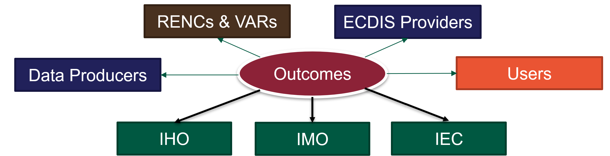
Project outputs
Project Report (incl. Press release)
Feedback to the IHO (potential standard issues)
Feedback to the IMO and IEC (as a safety case)
Australia S-100 National Stakeholders WG Meeting - 23 March 2023 Thomas Mellor (UKHO) - Christian Mouden (Shom)

Slide 11
Project management
Co-lead by UKHO and Shom
MS Teams website to share the documents, data, etc.
Monthly meetings (data providers, OEMS)
Australia S-100 National Stakeholders WG Meeting - 23 March 2023 Thomas Mellor (UKHO) - Christian Mouden (Shom)

Slide 12
Project challenges
The project scope has evolved since the first contacts (Oct. 2020)
Various dependancies (reason for a flexible timeline):
    Standard stability (versions in line with S-100 5.0.0);
    Production tools availability (critical for data production);
    OEMs system maturity;
Areas of data (except S-101) production to be defined with the local authorities, pilots, etc. (no need for S-102, S-104, S-111 « everywhere »).
Australia S-100 National Stakeholders WG Meeting - 23 March 2023 Thomas Mellor (UKHO) - Christian Mouden (Shom)

Slide 13
THANK YOU!
MERCI !

