Slide 1
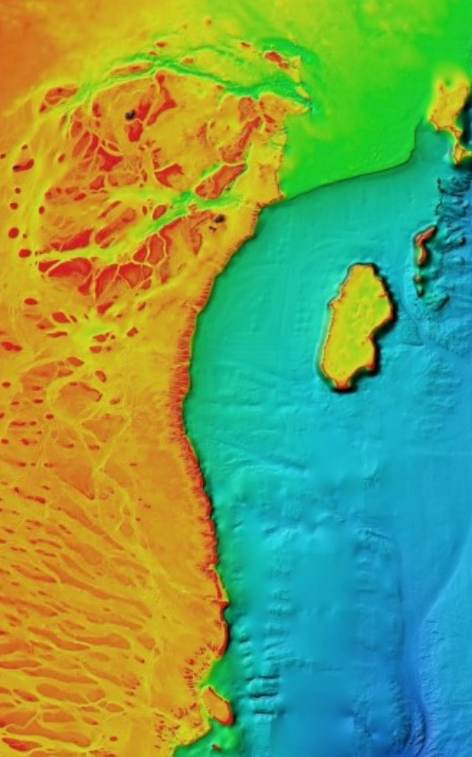
Georegulation - standardising the digital representation of maritime boundary data
Abstract: The IHO S-121 data interchange standard enables an open, international, coordinate-based, representation of maritime boundaries and their associated rights, restrictions, and responsibilities (RRRs) that are authoritative and easy to interpret. The standard has been published by the IHO and is currently informing the development of ISO 19152 Land Administration Domain Model (LADM) -- Part 3: Marine Georegulation.
This presentation will provide an overview of how the S-121 and 19152-3 standards have been developed and where Georegulation is going next.
Michael Hewett | GIS Analyst/Developer
Jonah Sullivan | Geospatial Advisor
Update to ICSM S-100 National Stakeholders Working Group 23 March 2023

Slide 2
Georegulation
The regulation of space – legal certainty in the spatial administration of jurisdiction
1982 – UN Convention on the Law of the Sea (UNCLOS)
2004 - UN General Assembly Resolution A/RES/59/24
  Requests the Secretary-General to improve the existing Geographic Information System for the deposit by States of charts and geographical coordinates concerning maritime zones…
  Passed on to the IHO and becomes start of S-121…
Authoritative Legislation
Operationally Useful Data
Legally Authoritative Digital Data
Notes:
Definition of Georegulation: the regulation of space
1971: Australia signed first maritime boundaries treaty with Indonesia
1982 Georegulation formally started with UNCLOS (40 years ago – 10 December 1982)
Requires coastal states to deposit charts or lists of coordinates representing inner and outer limits of
territorial sea,
contiguous zone,
Exclusive Economic Zone,
continental shelf,
delimitation between states
To ensure the international community is informed of the extent of maritime zones and the delimitation between states
No geographic system to handle the deposited charts or data
2004 the general assembly requests a system to handle digital data – goes to IHO and triggers start of S-121.

Slide 3
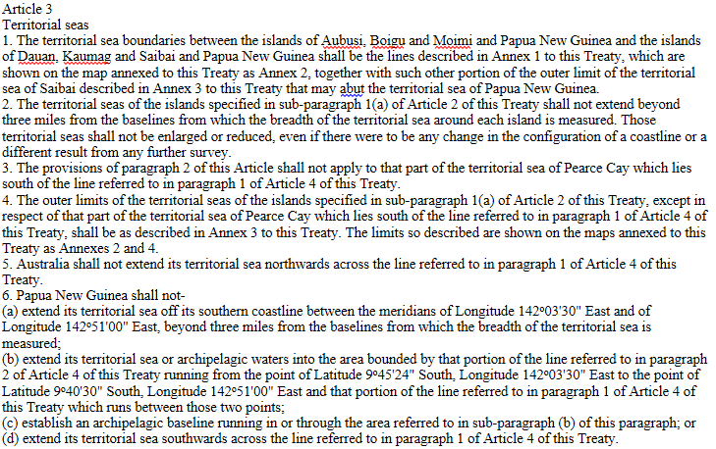
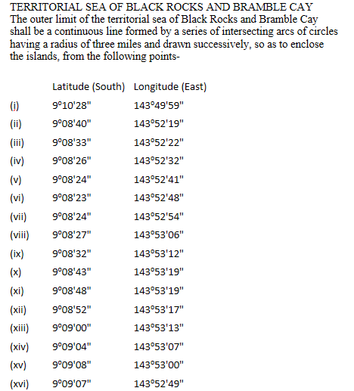
Extracts from 1985 AUS-PNG Treaty
Coordinates in AGD66, which is approx. 200m different to GDA94, GDA2020 or WGS84
Notes:
Currently, Australia declares it’s maritime boundaries in the form of legislative and treaty documents. These documents contain descriptions of the limits in reference to specified coordinates or geographic features. These documents form the Authoritative Legislation and are considered the Legal Authority when assessing limits for legal or operational purposes.
This extract shows an example of the text of a treaty.
The total treaty runs to 32 pages.
Continental shelf declaration runs to 400+ pages.
Many boundaries are defined by defining boundaries falling at a specified distance from the baseline, which is simple in theory, but:
- Baselines are not always shorelines
Different classifications of shore – Low Tide Elevations, High Water Features, etc
How do you know if you are 200nm from the nearest point on a baseline
Shorelines can be mobile
Climate change impacts
Different Coordinate systems – different measures, offsets of coodintate locations etc.

Slide 4
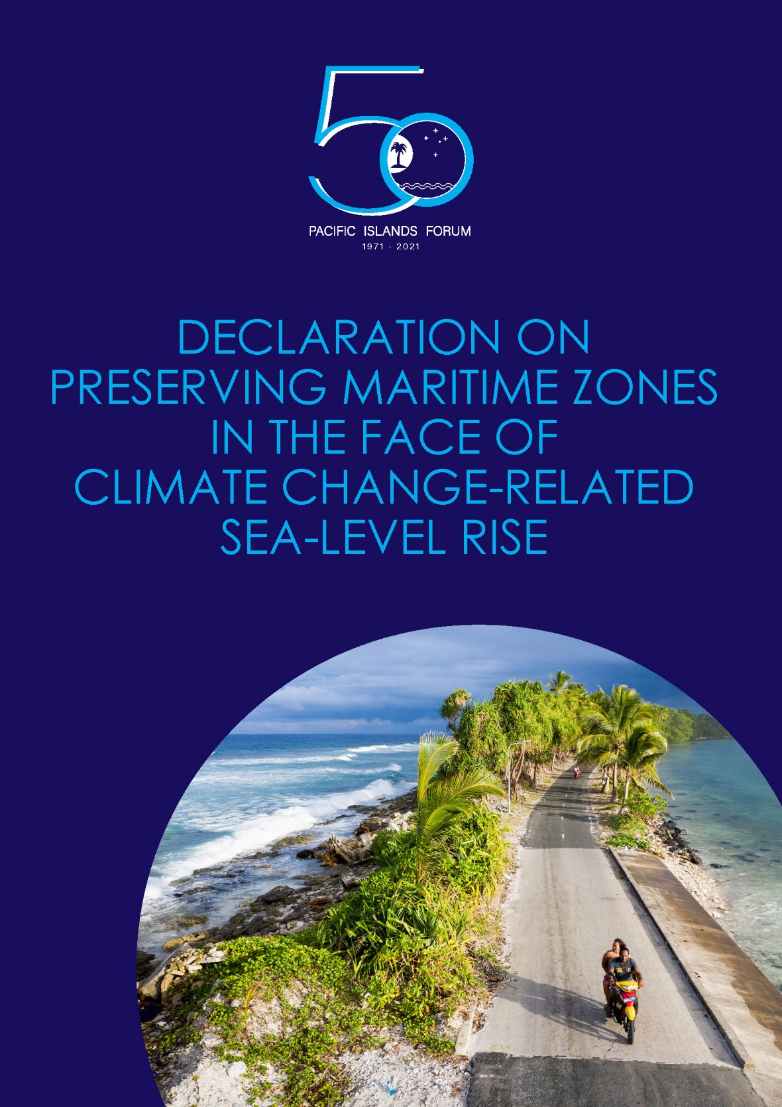

Pacific Statement 2021
We, The Leaders of the Pacific Islands Forum …
Declare that once having, in accordance with the Convention, established and notified our maritime zones to the Secretary-General of the United Nations, we intend to maintain these zones without reduction, notwithstanding climate change-related sea-level rise,
Further declare that we do not intend to review and update the baselines and outer limits of our maritime zones as a consequence of climate change-related sea-level rise, and
Proclaim that our maritime zones, as established and notified to the Secretary-General of the United Nations in accordance with the Convention, and the rights and entitlements that flow from them, shall continue to apply, without reduction, notwithstanding any physical changes connected to climate change-related sea-level rise.
https://www.forumsec.org/wp-content/uploads/2021/08/Declaration-on-Preserving-Maritime.pdf
Notes:
Pacific Statement 2021, signed by Australia’s Prime Minister
Declares that the inner and outer limit of maritime zones have fixed locations based on coordinates
Requires very good data to ensure that zones are legally defensible.

Slide 5
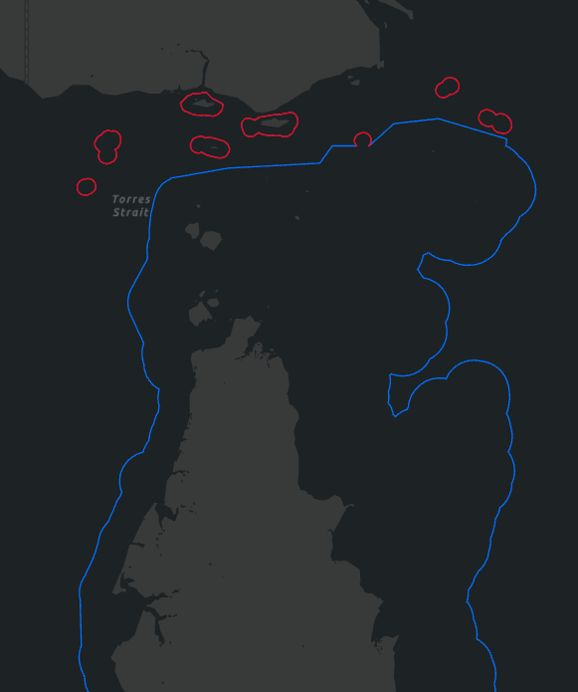
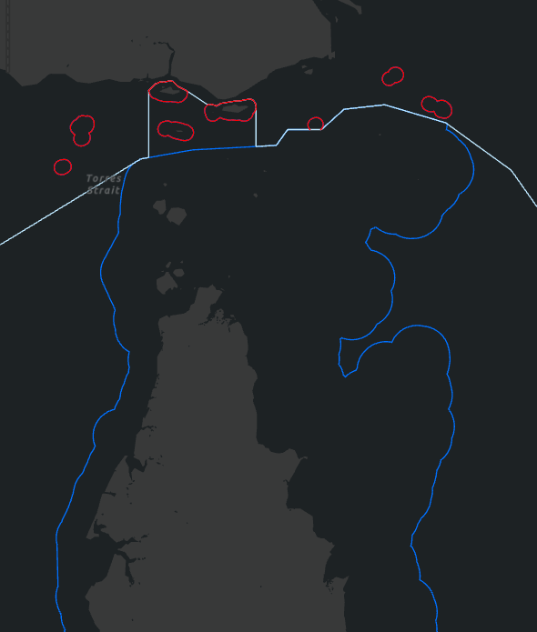
Digital Data Representation
Treaty Territorial Sea Limits
Seas and Submerged Lands Act Territorial Sea Limits
Exclusive Economic Zone Limits
Australia’s Territorial Sea (TS) Limits
TS Limit interaction with Exclusive Economic Zone
Notes:
To be converted to an Operational Dataset, the treaty documents usually need to be converted into ‘lines on a map’ for the information to be considered useful. In the modern day, the lines on a map are often digital datasets, with additional information associated with various points, lined and areas on the map.
In addition, there is often a complex set of interactions with the data.
White EEZ is defined as being a max of 200nm from the baseline.
Currently, Operational data is not the legal boundary, just a representation of the legal document.
In order for the data to be useful to a wide variety of users, the digital dataset needs to have a well organized and documented structure. This is where we begin to move into Standards.

Slide 6
Why Digital Data?
Assertion of Rights to Jurisdiction
Distribution of Rights, Restrictions, and Responsibilities
Implementation of Domestic Rights, Restrictions, and Responsibilities
Australia’s National Jurisdiction.
Determination of Commonwealth Boundaries, State/Territory Limits, and External Territories.
Native Title Determinations
Environmental Regulations
Migration Zone
Fisheries Regulations
Sea Dumping
Petroleum Titling
Crimes at Sea
Offshore Mining
Notes:
As part of the standards development, need to consider:
What data should be represented?
What is the use-case? Who are the users?
Assertion
Distribution
Implementation

Slide 7
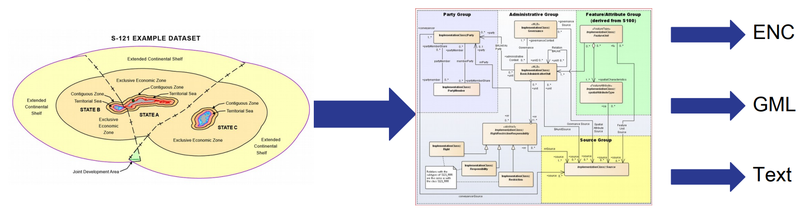
S-121 Maritime Limits and Boundaries
  Support the management, description and exchange of a State’s Maritime Sovereignty, Sovereign rights extents and associated juridical zones.
  The management of legal information is very different from the management of other types of GIS data.
Notes:
S-100 series is a new IHO data standard
upgrading the old E57 Electronic Nautical Chart standard
Expanded themes and data types
Primary purpose of nautical charts is safety of navigation
Additional data themes and authoritative datasets are becoming available to mariners
Seamless integration with Electronic Chart Display Information Systems (ECDIS)
S-121 is based on ISO 19152 – Land Administration Domain Model LADM
Purpose-built for maritime boundaries data
Bespoke RRRs and types of areas and limits
Multiple output formats, including
Electronic Nautical Charts (S-100 series)
GML for data exchange
Text as a legal document (lawyers don’t like data)
Conversion of legal documents into legal data

Slide 8
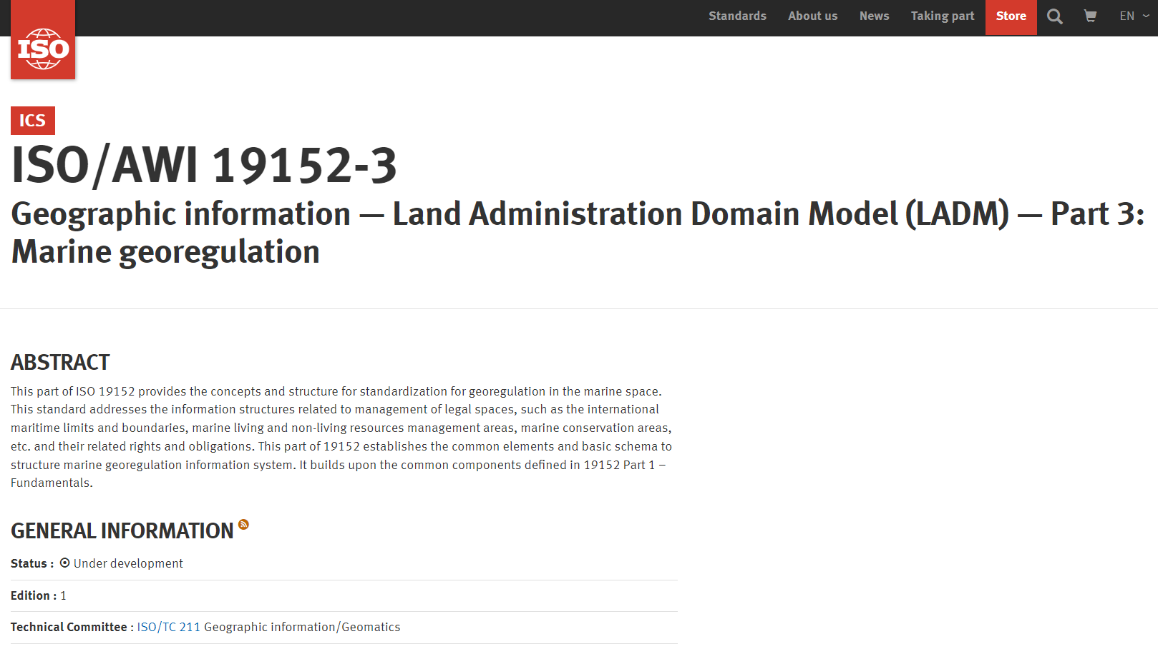
ISO 19152-3 Land Administration Domain Model (LADM)
Split into thematic parts
Part 1: Fundamentals
Part 2: Land registration
Part 3: Marine georegulation
Part 4: Valuation information
Part 5: Spatial plan information
Part 6: Implementation aspects
Notes:
ISO 19152 has been split into functional parts to break a giant standard into more manageable pieces.
S-121 has been lifted-and-shifted into ISO 19152 part 3
Domain-specific information, such as specific RRRs and zone types.
Enhances software integration opportunities and user base for authoritative data.

Slide 9
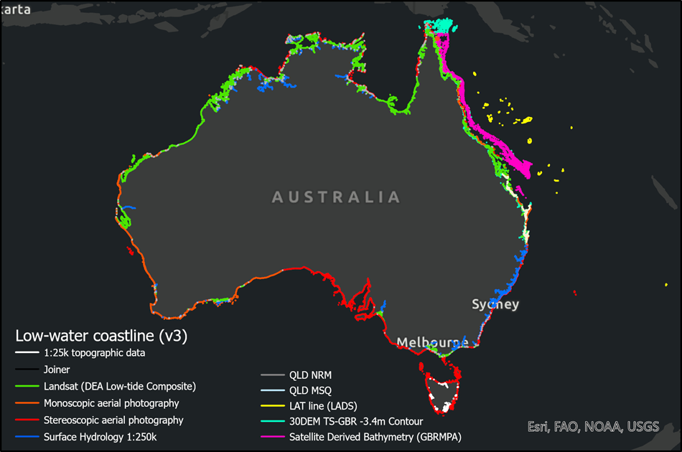
Coastline – resurvey over past 12 years via ICSM – will go into new standard
Notes:
A definitive geography of emergent features but a pathway to complexity
Note the:
Extra coastline in the GBR
Coastline behind straight baselines
Rivers
Some features still to capture (offshore of the Kimberley (Rowley Shoals, Scott Reef, Ashmore and Cartier), Christmas Island)
Ongoing development post derivation of the TSB
Feature names (Working Group on Place Names)

Slide 10
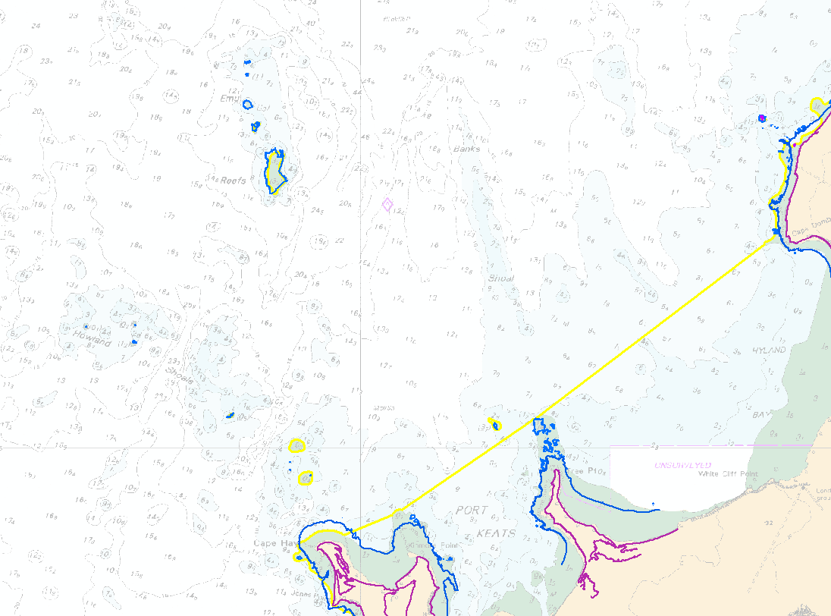
Low Tide Elevation vs Mean Water Line vs High Water Features

Slide 11
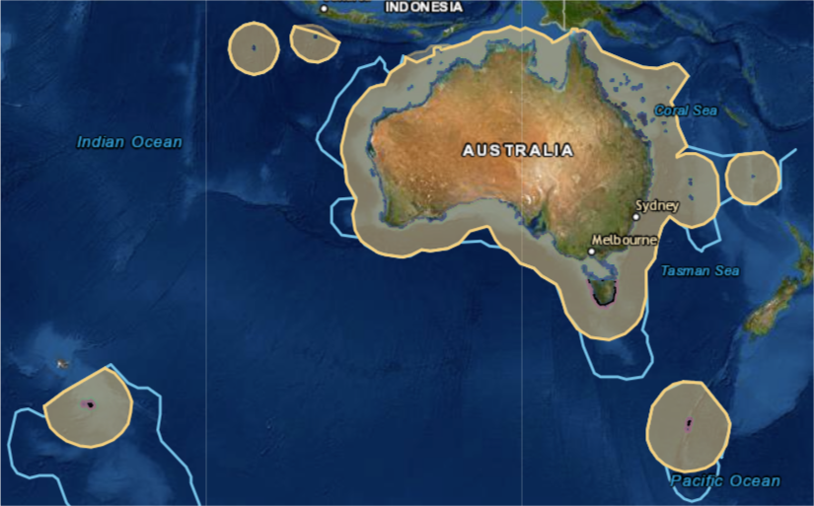
Revised Maritime Boundaries
Notes:
Revised boundaries based on updated coastline information
Current legislation is a list of coordinates
700 pages long
Unusable in an operational sense
Legally unwieldy
Requires expert witnesses to support legal prosecutions
New version will be in S-121 format
Legally authoritative digital data
Directly used in navigation and operating picture systems

Slide 12
Status as at March 2023
Internationally:
  Version 1.0.0 completed in October 2019 for implementation and testing purposes only.
  Open Geospatial Consortium implementation pilot conducted in 2020 – successful.
    Ingested into varous registers including data dictionaries, concepts and metadata
    Not yet used for portrayal of maritime boundaries
  Picked up by ISO through 19152-3 (land admin data model)
    12 week ballot now open on the draft standard
    “Final draft” standard for publication expected early 2024
In Australia:
  Data model developed to cover data management and publication
  Current version of maritime limits loaded for trialling the model – includes data defined on different projections and coordinate systems, generation of loxodromes / geodesics, by Treaty
  Using Esri
In Pacific:
  Geoscience Australia trialling implementation of S-121 with Pacific Island States through pilot projects funded by Department of Foreign Affairs
  3 countries trialled to date.

Slide 13

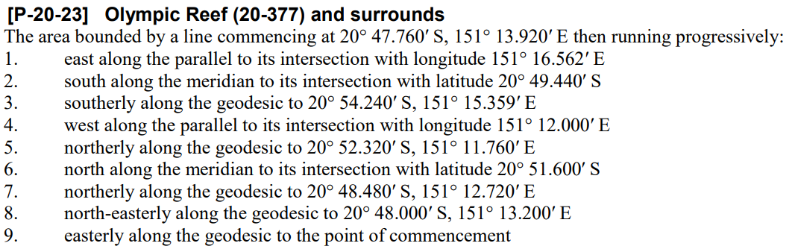
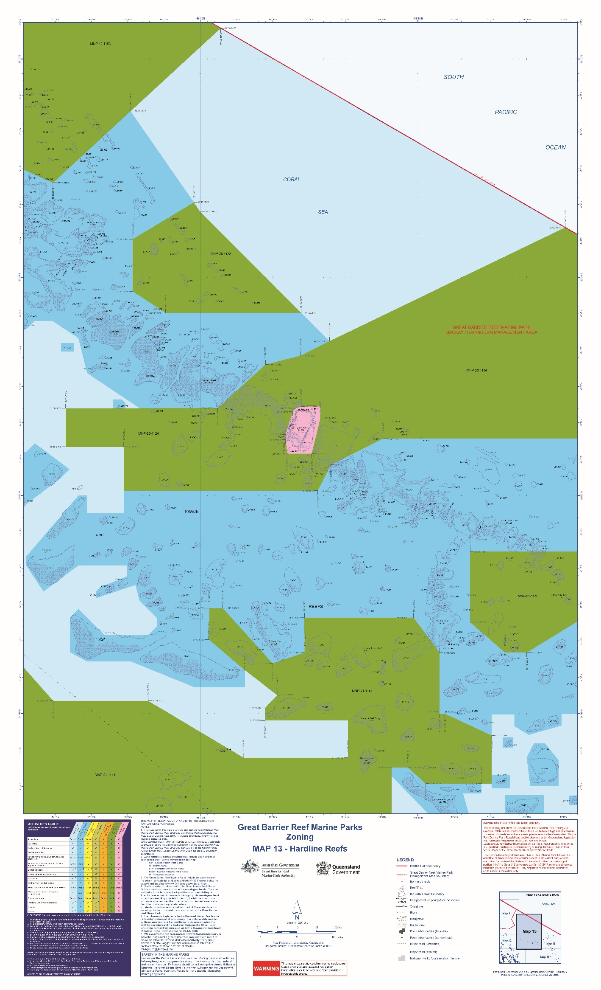
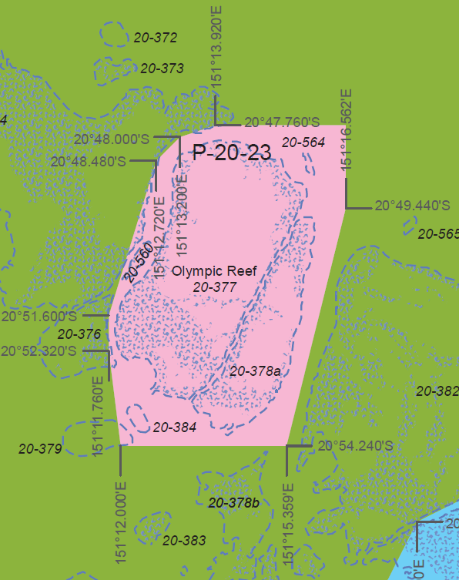
GBRMPA pilot for S-122
Authoritative Legislation
Operationally Useful Data
Legally Authoritative Digital Data
Notes:
Upcoming implementation of georegulation (RegTech) within the Great Barrier Reef Marine Park
Converting authoritative legislation and spatial data to legally authoritative digital data
Including a legal repository similar to the Federal Register of Legislation
Conversion of legal documents into legal data

Slide 14
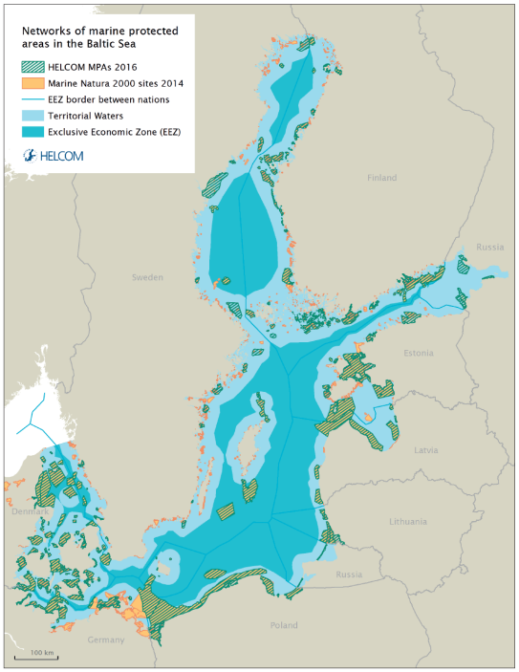

OGC Pilot Project: S-122 Marine Protected Areas
Regional Marine Spatial Data Infrastructure (MSDI)
  Based on binding legislation within member states and treaties between them
  North Sea and Baltic Sea as Testbed
OGC Initiative
First phase 2022
Second phase 2023
https://www.ogc.org/projects/initiatives/fmsdi
Notes:
S-122 is another IHO data standard in the S-100 series
Focussed on Marine Protected Areas
Includes rights – restrictions – responsibilities: sounds a lot like S-121

Slide 15

Evidenced
based decision
making
A trusted source
of data and
information
Collaboration,
cooperation and
partnership
Creating a
location-enabled
Australia
Notes:
So where to from here, call to action
Amplify direction of ANZLIC
National geospatial policy – what is this? What do we mean by this?
What is GA doing in terms of workforce with our people
Partnerships – what types of partnerships
What opportunities?

